Slide 1


Vocular: Voice Emotion Analyzer
MINOR PROJECT PRESENTATION
Team Members: - Lakshay Singhal - Tanishqa - Akshita Jain - Vikas

Slide 2
OBJECTIVE
Voice often reflects underlying emotion through tone and pitch.
Utilizing this phenomenon, the web app aims to identify sentiment of the person by their voice and suggests them what they really need based on their mood/sentiment at an instance of time and thereby providing a customized experience according to the mood of the user.
The model has the ability to detect basic emotions of the user through audio speech.
The emotional processing unit employs advances in the field of affective computing and machine learning in order to estimate the emotional state of the user.

Slide 3
ABSTRACT
An application that would comprise of voice recording, recognition and analysis and thereby concluding the emotions that a person has using machine learning algorithms.
In other words, the application does sentiment analysis on a voice that can be recorded in real time via the recorder provided in the app.
The type of sentiments that can be analyzed and recognized from the voice of the user are happy, calm, sad, angry, fearful, neutral, disgust and surprised.
As a result of the emotion that is recognized, the application suggests some things in which a person can get involved in.
The application can suggest some books, videos, quotes, songs, events happening around from the database and can redirect the user so that he/she can view the details of the same.

Slide 4


Example
For example, the app can suggest some inspirational books, quotes for a person whose sentiment was detected sad and some videos, events that are happening around to further boost the mood of a person detected happy.

Slide 5
The application comes with two options that either a user can record his/her voice to predict the sentiment or he/she can directly use the sound or speech from their system.
The sentiment is analyzed on the basis of the pitch, intensity, loudness and other aspects of the sound. The type of sentiments that can be analyzed and recognized from the voice of the user are happy, calm, sad, angry, fearful, neutral, disgust and surprised.
RAVDESS contains 1440 files: 60 trials per actor x 24 actors = 1440. The RAVDESS contains 24 professional actors (12 female, 12 male), vocalizing two lexically-matched statements in a neutral North American accent.

Slide 6
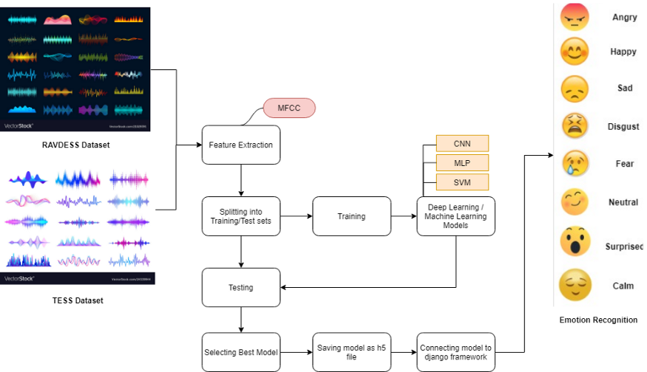

Slide 7
TECHNOLOGY
The following are the technologies used in this project:
Frontend: Html, CSS, JavaScript
Backend: Python3
Web Framework: Flask
Machine Learning and Python Libraries: librosa, numpy, joblib, sklearn, keras, tensorflow.

Slide 8
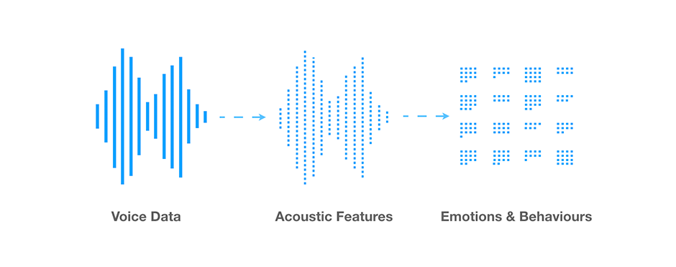
The app integrates ML with web framework and uses python library for analyzing audio and music and machine learning algorithms for training and classification.
The basic idea for machine learning classification of voice data is to extract certain characteristics of the waveform that can be used as features to train a machine learning classifier.
Given a collection of speech recordings, manually labelled with the emotion expressed, we can construct vector representations of each recording using the extracted features.
Once the features are extracted and the vector representations of speech constructed, a classifier is trained to detect emotions.

Slide 9
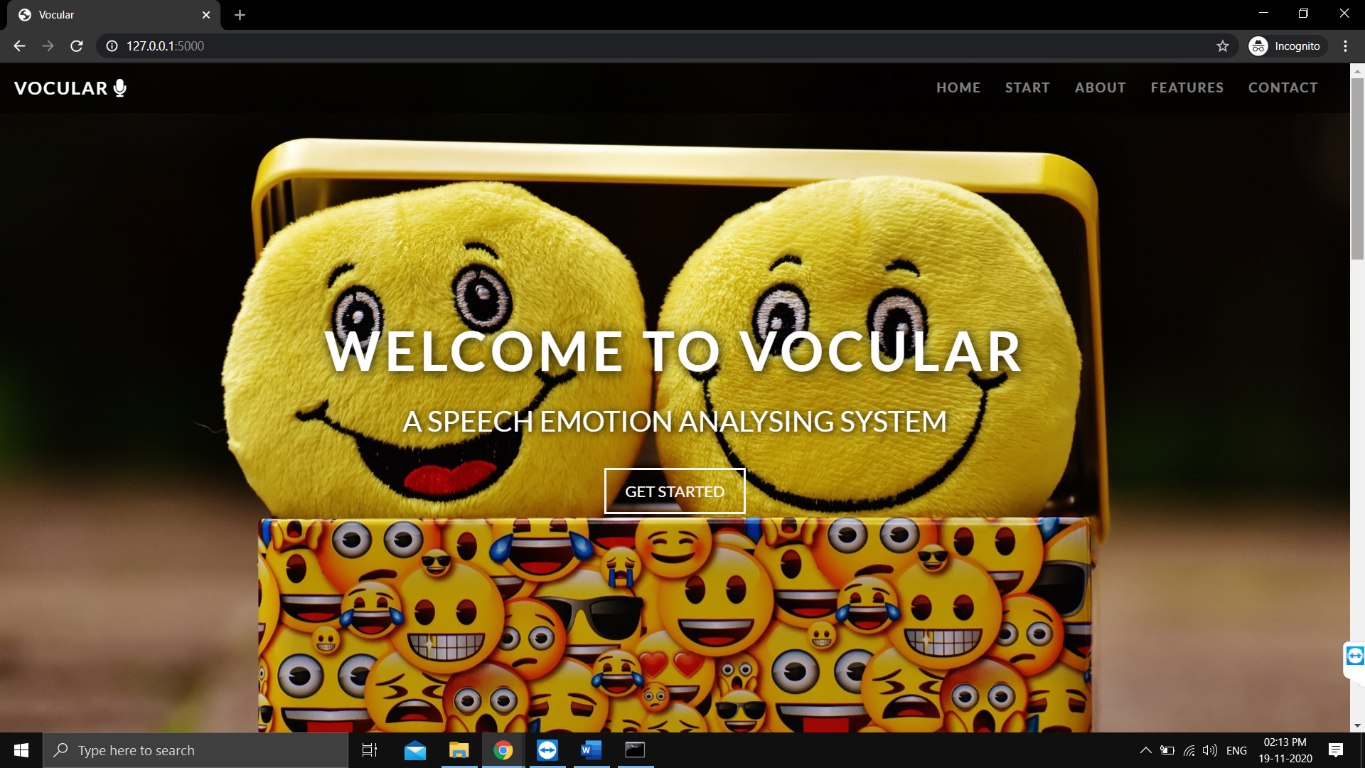
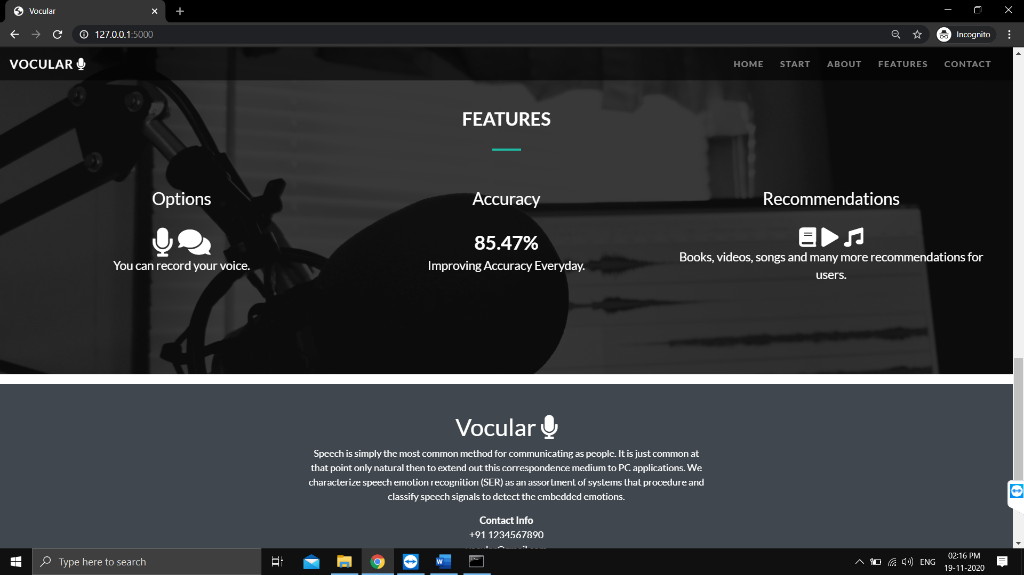
Screenshots of the Project

Slide 10
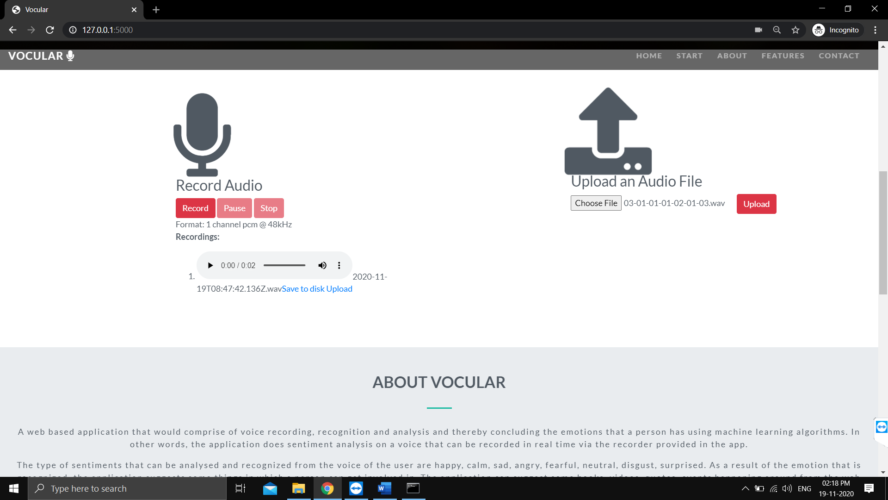
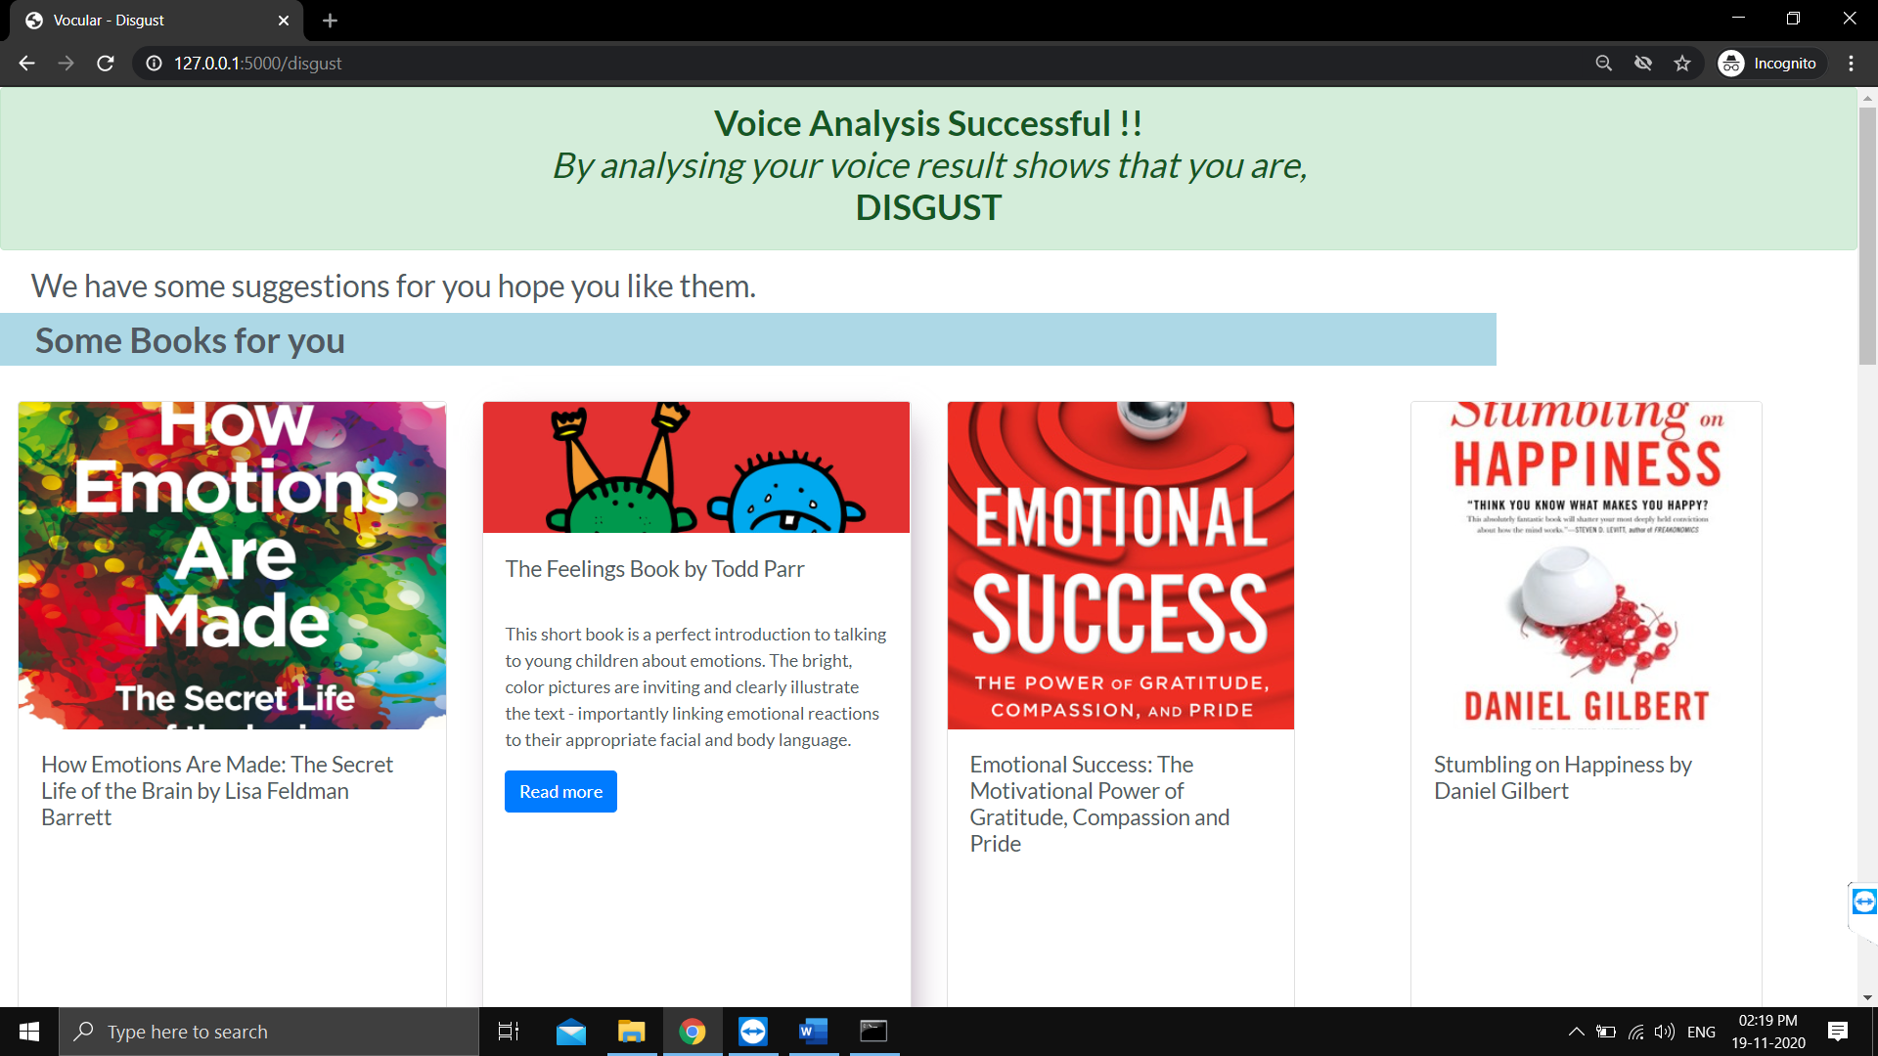

Slide 11
Conclusion
In this project, we have used CNN (Convolution Neural Networks) with training data = 67% and test data = 33%.
We have identified and detailed the parts that make up a speech emotion recognition system. These systems require training data provided by speech databases that are created using either acted, elicited, or natural sources. The signals are then pre-processed to make them fit for feature extraction.
The accuracy from our model is 85.47%.

Slide 12
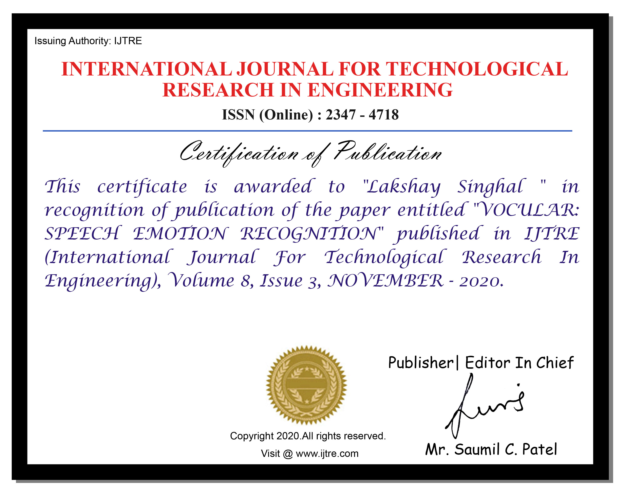




Slide 13


Slide 14
Thank You ! ☺

